Slide 1
Chhattisgarh Yatra
Shri Shankaracharya Institute of Professional Management & Technology, Raipur
Major Project(Phase-I) Report on
CSE 7th Semester
Department of Computer Science and Engineering,
Batch 2019-2023
Session Nov – Dec 2022-23
24/01/23
Project Group Members:
Sakshi Bhuwal
Shubhika Shukla
Himanshi Malagar
Project Guide
Mr. Abhishek Saw
(Asst. Professor, CSE)

Slide 2
Introduction about Project
Chhattisgarh has positioned itself as the destination full of surprises with some of the amazing destinations which could certainly lead to the growth of tourism in the future. It has created a niche for itself on the tourist map of India.The state is covered with nearly 45% of the forests and 32% of tribal population, therefore, it offers immense opportunities for Eco-Ethno, Adventure and Cultural tourism
We have developed Chhattisgarh yatra application to provide a search platform find their tour places according to their choices. This is instead of to provide the best traveling services to the customers and travel agents. We have expanded tours and travel administration strategy to provide an exploration platform where a tourist can find their trip spots according to their choices

Slide 3
Application Area
Why did you opt to work on this project?
We are working on this project because Chhattisgarh is an underdeveloped state and a lot of people don’t know about it.
What are the Applications and Benefits of this project?
The application of this projects are that a user can explore chhattisgarh via this application and use it as a local tourist guide.
Who are the End Users of this project?
The tourists visiting places in chhattisgarh are the end users of the project.

Slide 4
Literature Review
Information search (traveller’s perspectives), and market segmentation by information/booking channel. Perspective the reasons why travellers make use of different sources of information are investigated, whereas using another perspective, the observable outcome of that behaviour is raised.
Although, there is many things that we learn and know about the places in detail very well. It helps to know about the ancient things & their cultures in detail. Grand Tour, education, higher education, travel & tourism is the main topics for learn & discuss about it.
Tour and travel information is obtained mainly through communication media like newspaper, magazines etc. Today's mobile devices are becoming more intelligent, which provides information in mobile itself. Mobile Technology is now set to improve tourism in various fields. Due to busy schedule people want quick and easy ways to obtain information of all kinds and tourism is no different. Thechhattisgarh yatra application is tour management system which is based on internet provides self-guidance for tourists in mobile phones

Slide 5
Methodology
Experimental Setup
Developer:-
Software Required (With Versions duly mentioned)
-React-Native (0.68 )
-NodeJs (V17.9.0 or Higher)
-MongoDb ( 5.0.6 or higher)
-Github (3.3.5 or higher)
-Python ()
-Google Colab
-IDE (Using VS Code of V1.66.1 or Higher)
Hardware Requirement
-RAM -8GB(recommended)

Slide 6
Methodology
Experimental Setup
End User:-
Software’s Required (With Versions duly mentioned)
Android(10 - Android Q)
Hardware Required
Global Positioning System
Mobile phone (4GB min)

Slide 7
Methodology
Experimental Setup
Front End Details:-
There will be a total of 9 Interfaces/Screens in this application. They include
1.HomeScreen
2. Discover page
3. Accommodations page
4. Transportation page
5. Restaurants
6. Log-in/ Sign-in page
7. Scheduling page
8. Transactions page
9. Confirmation page

Slide 8
Methodology
Database Used
MySQL

Slide 9
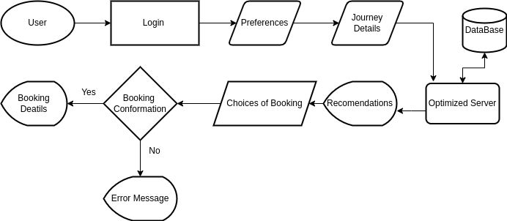
Project Work Flow Diagram

Slide 10
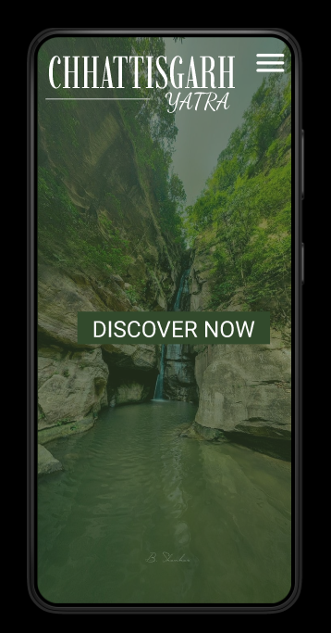
Result & Conclusion
Snapshot with description
Home page - The page shows the first page that a user would come across once he open the app. The page allows the user to discover places under different categories , log option , a menu bar etc.

Slide 11
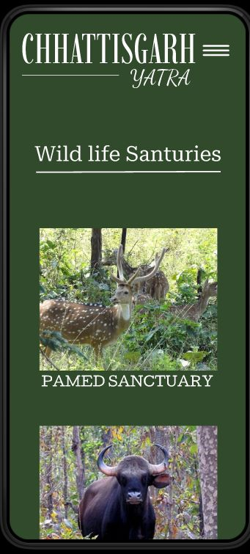
Result & Conclusion
Snapshot with description
Wild life sanctuaries - Chhattisgarh is a state of forests and tribal communities. We have added every but of flora and fauna that is in the state

Slide 12
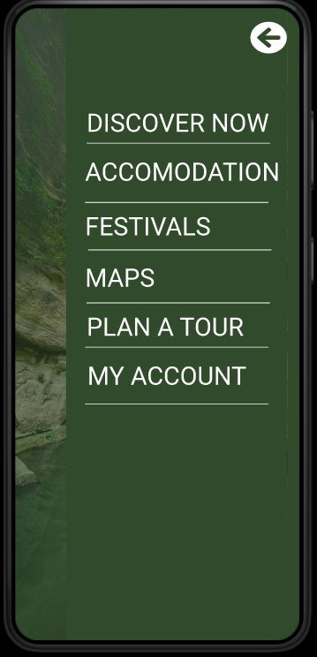
Result & Conclusion
Snapshot with description
Menu Bar - menu bar represents all the features in one place. Accommodation, festivals, maps plan a tour are a few options to name.

Slide 13
References
https://reactjs.org/tutorial/tutorial.html - A complete guide to the front-end developing software React JS.
https://www.mongodb.com/cloud/atlas/
https://www.w3schools.com/nodejs/
https://www.w3schools.com/react/react_getstarted.asp
https://www.chhattisgarhtourism.in/
https://twitter.com/GoChhattisgarh?ref_src=twsrc%5Egoogle%7Ctwcamp%5Eserp%7Ctwgr%5Eauthor
https://www.indianholiday.com/tours-of-india/best-of-chhattisgarh.html.

Slide 14
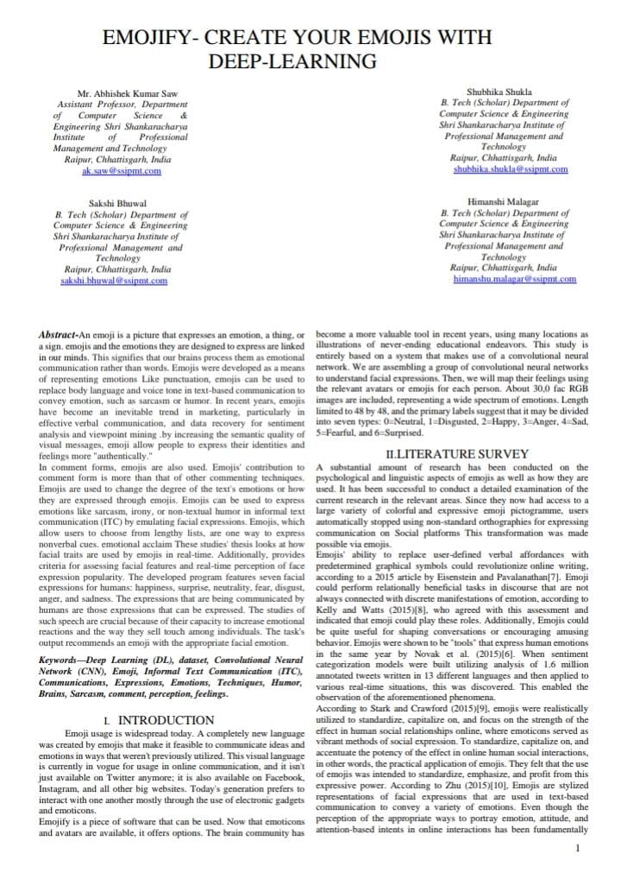
Paper Publication Details

Slide 15
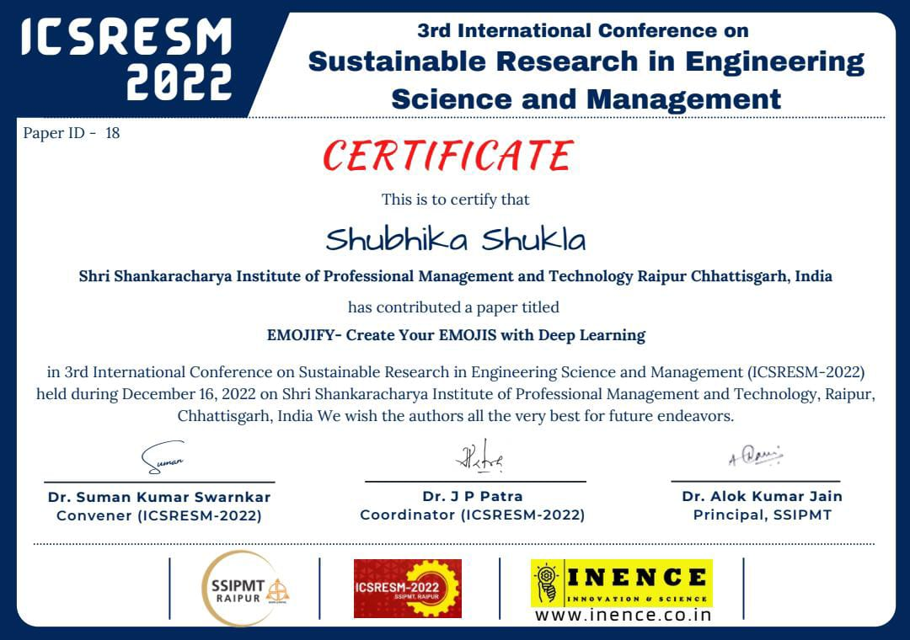
Paper Publication Details

Slide 16

Paper Publication Details

Slide 17

Paper Publication Details

